Slide 1



Interval Trees, Quad Trees, K-d Trees
Space Partitioning Trees
Tree-Like Structures
SoftUni Team
Technical Trainers
Software University
http://softuni.bg

Slide 2

Table of Contents
Interval Trees
Interval Intersection Search
Quad Trees
Rectangle Intersection Search
K-d Trees
Point Range Search

Slide 3
Have a Question?
sli.do #DsAlgo

Slide 4
Interval Trees
(20..36)
(3..41)
(29..99)
(0..1)
(10..15)
(25..30)
Properties and Rotations

Slide 5
Interval Trees
Interval tree is a modified BST that stores intervals
Efficient search for all intervals that overlap a given interval
(20..36)
(3..41)
(29..99)
 | Average | Worst case
Space | O(n) | O(n)
Search | O(log n + m) | O(log n + m)
Insert | O(log n) | O(log n)
Delete | O(log n) | O(log n)
(0..1)
(10..15)
(25..30)

Slide 6
Interval Intersection
A and B intersects if:
Overlapping
Non overlapping
A.start < B.end && A.end > B.start
А
A
A
A
B
B
B
B
A
A
B
B

Slide 7
Intervals - Quiz
TIME’S UP!
TIME:
Which intervals overlap with (7, 13)
(1,6)
(8,12)
(15,32)
(-2,15)

Slide 8

Intervals - Quiz
TIME’S UP!
Which intervals overlap with (7, 13)
(1,6)
(8,12)
(15,32)
(-2,15)

Slide 9
Interval Trees
Elements are ordered by interval start
In-order by interval start
(20..36)
99
(3..41)
41
(29..99)
99
(0..1)
1
(10..15)
15
(25..30)
30

Slide 10
Interval Trees (2)
Each node stores subtree max endpoint
Subtree max endpoint
(20..36)
99
(3..41)
41
(29..99)
99
(0..1)
1
(10..15)
15
(25..30)
30

Slide 11
Search Any
Search for any interval that intersects with a given interval i
let x = root
while x != null && x is not intersected
if x.left != null && x.left.max ≥ i.start
x = x.left
else
x = x.right
return x

Slide 12
Search Any #1
Search for i = (12, 14)
Start at (20, 36)
x.left.max > i.start → left
(20..36)
99
(3..41)
41
(29..99)
99
(0..1)
1
(10..15)
15
(25..30)
30

Slide 13
Search Any #2
Search for i = (12, 14)
x.left.max is not ≥ i.start → right
(20..36)
99
(3..41)
41
(29..99)
99
(0..1)
1
(10..15)
15
(25..30)
30

Slide 14
Search Any #3
Search for i = (12, 14)
x intersects i → return x
(20..36)
99
(3..41)
41
(29..99)
99
(0..1)
1
(10..15)
15
(25..30)
30

Slide 15
Search Any - Miss #1
Search for i = (45, 52)
x.left.max is not ≥ i.start → right
(20..36)
99
(3..41)
41
(29..99)
99
(0..1)
1
(10..15)
15
(25..30)
30

Slide 16
Search Any - Miss #2
Search for i = (45, 52)
x.left.max is not ≥ i.start → right
(20..36)
99
(3..41)
41
(29..99)
99
(0..1)
1
(10..15)
15
(25..30)
30

Slide 17
Search Any - Miss #2
Search for i = (45, 52)
x = null → return null
(20..36)
99
(3..41)
41
(29..99)
99
(0..1)
1
(10..15)
15
(25..30)
30
null

Slide 18
Search All
For given interval i we search:
All nodes to the left where x.left.max > i.start
All nodes to the right where x.start < i.end
A.s B.s A.e B.e
(20..36)
99
(3..41)
41
(29..99)
99
All intersecting (10,50)
(0..1)
1
(10..15)
15
(25..30)
30

Slide 19
Search All #1
Search for i = (10, 50)
(20, 36) intersects (10, 50)
x.left.max > i.start → go left
Result: (20,36)
(20..36)
99
(3..41)
41
(29..99)
99
(0..1)
1
(10..15)
15
(25..30)
30
(60..72)
72

Slide 20
Search All #2
Search for i = (10, 50)
(3, 41) intersects (10, 50)
x.left.max not > i.start → skip left
Result: (20,36), (3,41)
(20..36)
99
(3..41)
41
(29..99)
99
(0..1)
1
(10..15)
15
(25..30)
30
(60..72)
72

Slide 21
Search All #3
Search for i = (10, 50)
(3, 41) intersects (10, 50)
x.right.start < i.end → go right
Result: (20,36), (3,41)
(20..36)
99
(3..41)
41
(29..99)
99
(0..1)
1
(10..15)
15
(25..30)
30
(60..72)
72

Slide 22
Search All #4
Search for i = (10, 50)
(10, 15) intersects (10, 50)
left & right = null → go up
Result: (20,36), (3,41), (10,15)
(20..36)
99
(3..41)
41
(29..99)
99
(0..1)
1
(10..15)
15
(25..30)
30
(60..72)
72

Slide 23
Search All #5
Search for i = (10, 50)
left & right = done → go up
Result: (20,36), (3,41), (10,15)
(20..36)
99
(3..41)
41
(29..99)
99
(0..1)
1
(10..15)
15
(25..30)
30
(60..72)
72

Slide 24
Search All #6
Search for i = (10, 50)
left = done
x.right.start < i.end → go right
Result: (20,36), (3,41), (10,15)
(20..36)
99
(3..41)
41
(29..99)
99
(0..1)
1
(10..15)
15
(25..30)
30
(60..72)
72

Slide 25
Search All #7
Search for i = (10, 50)
(29, 99) intersects i
x.left.max > i.start → go left
Result: (20,36), (3,41), (10,15), (29,99)
(20..36)
99
(3..41)
41
(29..99)
99
(0..1)
1
(10..15)
15
(25..30)
30
(60..72)
72

Slide 26
Search All #8
Search for i = (10, 50)
(25, 30) intersects i
left & right = null → go up
Result: (20,36), (3,41), (10,15), (29,99), (25,30)
(20..36)
99
(3..41)
41
(29..99)
99
(0..1)
1
(10..15)
15
(25..30)
30
(60..72)
72

Slide 27
Search All #9
Search for i = (10, 50)
x.right.start > i.end → go up
Result: (20,36), (3,41), (10,15), (29,99), (25,30)
(20..36)
99
(3..41)
41
(29..99)
99
(0..1)
1
(10..15)
15
(25..30)
30
(60..72)
72

Slide 28
Search All #10
Search for i = (10, 50)
back at root → over
Result: (20,36), (3,41), (10,15), (29,99), (25,30)
(20..36)
99
(3..41)
41
(29..99)
99
(0..1)
1
(10..15)
15
(25..30)
30
(60..72)
72

Slide 29
Sweep Line Rectangle Intersection
Given N rectangles, find all that intersect each other

Slide 30
Sweep Line Rectangle Intersection
Save all rectangles left & right endpoint in sorted order

Slide 31
Sweep Line Rectangle Intersection
left endpoint: interval search + insert interval

Slide 32
Sweep Line Rectangle Intersection
left endpoint: interval search + insert interval

Slide 33
Sweep Line Rectangle Intersection
left endpoint: interval search + insert interval
Search hit

Slide 34
Sweep Line Rectangle Intersection
right endpoint: remove interval

Slide 35
Sweep Line Rectangle Intersection
right endpoint: remove interval

Slide 36
Sweep Line Rectangle Intersection
left endpoint: interval search + insert interval

Slide 37
Sweep Line Rectangle Intersection
right endpoint: remove interval

Slide 38
Sweep Line Rectangle Intersection
right endpoint: remove interval

Slide 39
Quad Trees
Properties and Rotations

Slide 40
Quad Trees
Quad-Trees are 2D space partitioning trees
Recursively divide space into quads (quadrants)
Each node has 0 or 4 children
Offer efficient bounds check for collision detection

Slide 41
QuadTree: Insertion
void Insert(element)
node = root;
while (node.Children != null)
quadrant = Get-Quadrant(node, element)
if (quadrant == -1) break;
node = node.Children[quadrant]
node.Elements.Add(element)
Try-Split(node)
Returns child where element can be inserted
Split node into 4 children if max element capacity is reached

Slide 42
Quad Trees Insertion
Insert

Slide 43
Quad Trees Insertion
Insert

Slide 44
Quad Trees Insertion
Insert

Slide 45
Quad Trees Insertion
Insert
Node has 4 elements → split

Slide 46
Quad Trees Insertion
Create 4 child nodes

Slide 47
Quad Trees Insertion
Move into 0th quadrant

Slide 48
Quad Trees Insertion
Move into 1st quadrant

Slide 49
Quad Trees Insertion
Move into 3rd quadrant
Cannot move

Slide 50
Quad Trees Insertion
Insert
Try to insert it at the deepest level
Fits into 3rd quadrant

Slide 51
Quad Trees Insertion
Move into 3rd quadrant

Slide 52
Quad Trees Insertion
Insert
Try to insert it at the deepest level
Fits into 3rd quadrant

Slide 53
Quad Trees Insertion
Move into 3rd quadrant

Slide 54
Quad Trees Insertion
Insert
Try to insert it at the deepest level
Fits into 3rd quadrant

Slide 55
Quad Trees Insertion
Move into 3rd quadrant
Node elements == 4 → Split

Slide 56
Quad Trees Insertion
Subdivide 3rd quadrant into 4

Slide 57
Quad Trees Insertion
Move

Slide 58
Quad Trees Insertion
Move

Slide 59
Quad Trees Insertion
Move

Slide 60
Quad Trees Insertion
Insert

Slide 61
Quad Trees Insertion
Insert

Slide 62
Quad Trees Search
Search potential collisions with
If it fits, add elements and go to quadrant
If it doesn't, add all in node + children

Slide 63
Quad Trees Search
fits into 3rd → go to 3rd
Result:

Slide 64
Quad Trees Search
doesn't fit anywhere → add all in node + children
Result:

Slide 65
Quad Trees Search
doesn't fit anywhere → add all in node + children
Result:

Slide 66
Quad Trees Search
doesn't fit anywhere → add all in node + children
Result:

Slide 67
Quad Trees Search
doesn't fit anywhere → add all in node + children
Result:

Slide 68
Quad Trees Search
doesn't fit anywhere → add all in node + children
Result:
Over

Slide 69
Trees - Quiz
TIME’S UP!
TIME:
Show results from search for in quad tree

Slide 70
Trees - Quiz
TIME’S UP!
Elements:

Slide 71

Lab Exercise
Quad Trees

Slide 72
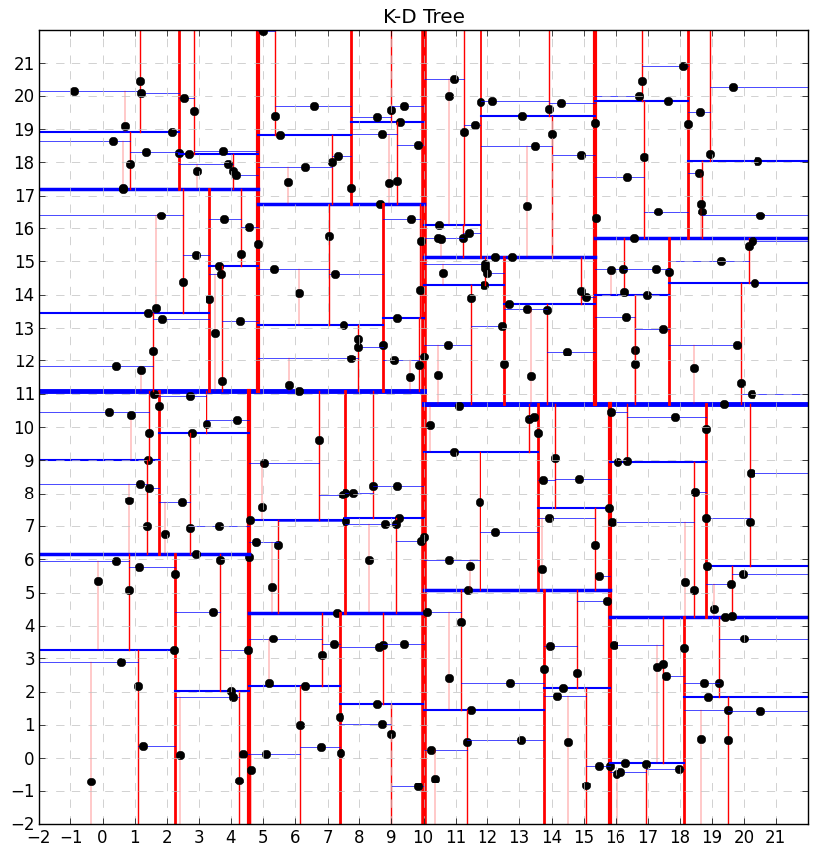
K-D Trees
Insertion Algorithm

Slide 73
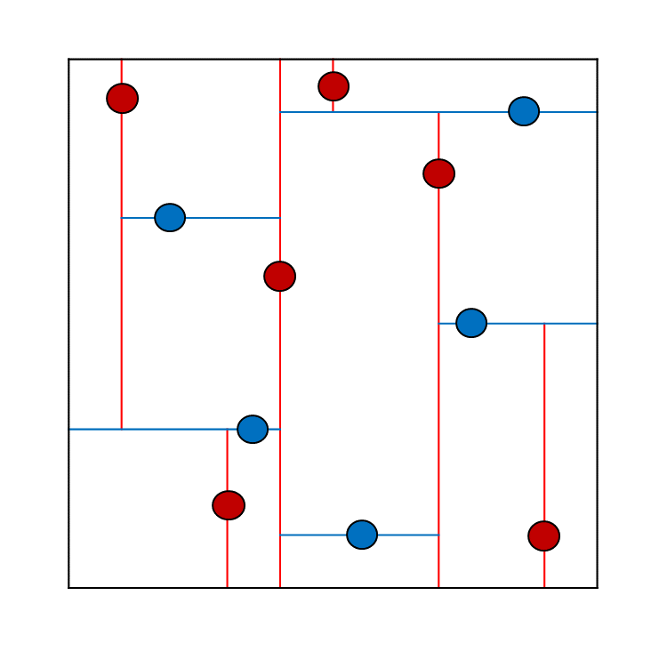
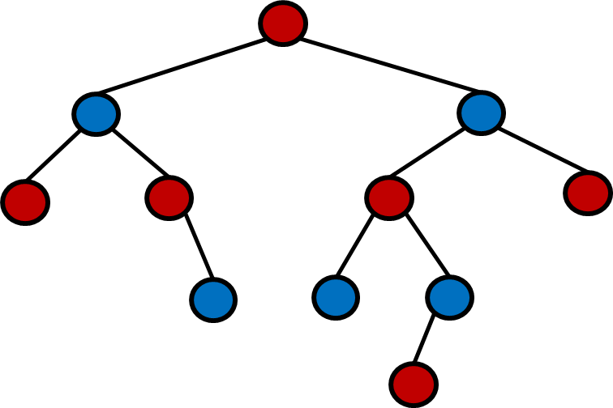
2-d Tree
2-d tree is a space-partitioning data structure for organizing points in a 2-dimensional space
Еvery node is a 2-dimensional point
Еvery point splits its own plane in half

Slide 74
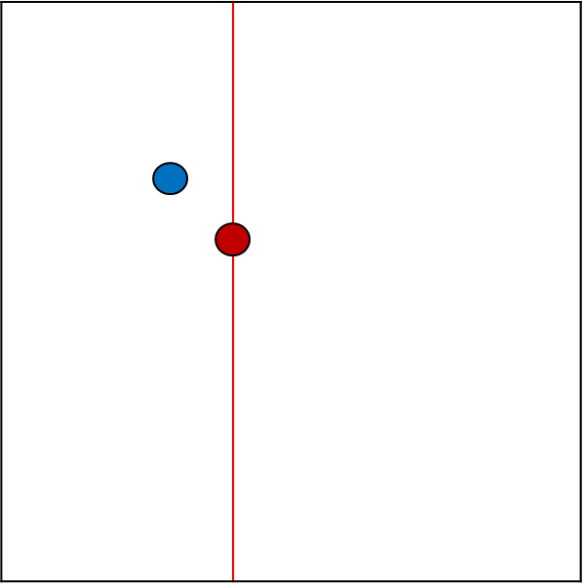
2-d Tree
On insertion →
if depth % 2 == 0 → compare points by X
if depth % 2 == 1 → compare points by Y
Point at (4, 6)
Point at (3, 7)
(3, 7)
(4, 6)
(4, 6)
0
1
(3, 7)

Slide 75
2-d Tree Insert
depth % 2 == 0 → split by X
0
1
2
3
4

Slide 76
2-d Tree Insert
compare by X → go left
depth % 2 == 1 → split by Y
0
1
2
3
4

Slide 77
2-d Tree Insert
compare by X → go left
depth % 2 == 1 → split by Y
0
1
2
3
4

Slide 78
2-d Tree Insert
compare by X → go left
0
1
2
3
4

Slide 79
2-d Tree Insert
compare by Y → go right
0
1
2
3
4

Slide 80
2-d Tree Insert
depth % 2 == 0 → split by X
0
1
2
3
4

Slide 81
2-d Tree Insert
compare by X → go left
0
1
2
3
4

Slide 82
2-d Tree Insert
compare by Y → go right
0
1
2
3
4

Slide 83
2-d Tree Insert
compare by X → go right
0
1
2
3
4

Slide 84
2-d Tree Insert
compare by X → go right
0
1
2
3
4

Slide 85
2-d Tree Insert
depth % 2 == 1 → split by Y
0
1
2
3
4

Slide 86
2-d Tree Insert
depth == 0 → compare by X
→ go right
0
1
2
3
4

Slide 87
2-d Tree Insert
depth % 2 == 1 → split by Y
0
1
2
3
4

Slide 88
2-d Tree Insert
depth % 2 == 1 → split by Y
0
1
2
3
4

Slide 89
2-d Tree Insert
0
1
2
3
4

Slide 90
2-d Tree Insert
0
1
2
3
4

Slide 91
2-d Tree Insert
0
1
2
3
4

Slide 92
2-d Tree Insert
0
1
2
3
4

Slide 93
2-d Tree Insert
0
1
2
3
4

Slide 94
2-d Tree Insert
0
1
2
3
4

Slide 95
2-d Tree Insert
0
1
2
3
4

Slide 96
2-d Tree Insert
0
1
2
3
4

Slide 97
2-d Tree Insert
0
1
2
3
4

Slide 98
2-d Tree Insert
0
1
2
3
4

Slide 99
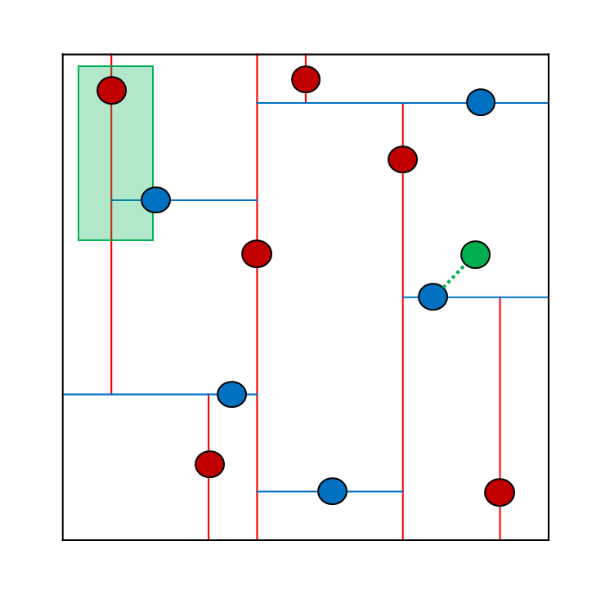
Range Search
Point in a Given Rectangle

Slide 100
K-d Tree Search
Efficient search for:
Nearest neighbour
Range search
(4, 6)

Slide 101

Summary
Interval
K-d

Slide 102








K-d Trees, Interval Trees
https://softuni.bg/trainings/1308/data-structures-february-2016

Slide 103
License
This course (slides, examples, labs, videos, homework, etc.) is licensed under the "Creative Commons Attribution-NonCommercial-ShareAlike 4.0 International" license
Attribution: this work may contain portions from
"Fundamentals of Computer Programming with C#" book by Svetlin Nakov & Co. under CC-BY-SA license
"Data Structures and Algorithms" course by Telerik Academy under CC-BY-NC-SA license

Slide 104





Free Trainings @ Software University
Software University Foundation – softuni.org
Software University – High-Quality Education, Profession and Job for Software Developers
softuni.bg
Software University @ Facebook
facebook.com/SoftwareUniversity
Software University @ YouTube
youtube.com/SoftwareUniversity
Software University Forums – forum.softuni.bg

